Slide 1
Pilot Biometrics
ECG Waveform Captures
Team sdmay18-12
https://sdmay18-12.sd.ece.iastate.edu/
Ryan Gallus (CprE)
Zach Glanz (CprE)
Justin Bader (CprE)
Andrew Jones (SE)
Kory Gray (CprE)
David Kirpes (EE)
Client: Rockwell Collins
Adviser: Akhilesh Tyagi

Slide 2
Problem Statement
Develop a device that will capture, monitor, and analyze the ECG waveform of a military pilot in flight, to be used during training operations.
Use four high-fidelity ECG sensors to collect an accurate waveform, then filter out background noise and interference.
Analyze the waveform data to detect if the pilot is in distress
Store an encrypted copy of the data and package a copy for real-time transmission to the ground through a component in the cockpit.
Pilot Biometric - ECG Waveform Captures sdmay18-12

Slide 3
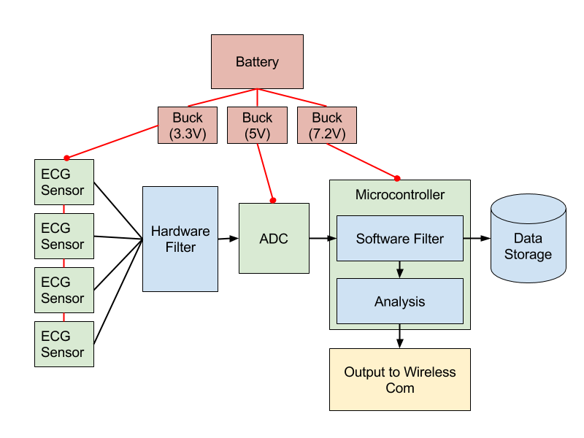
Conceptual Sketch
Pilot Biometric - ECG Waveform Captures sdmay18-12

Slide 4
Functional Requirements
Accurately detect a pilot in distress
Capture ECG waveform of pilot in operation
Accurately identify distress based on waveform
4-5 hours of continuous operation
Consistent and reliable power supply
Notify ground station
Communicate danger to pilot without increasing distress
Communicate with ground teams
Store 4-5 hours of operational data
Operate in real time on an ARM microcontroller
Pilot Biometric - ECG Waveform Captures sdmay18-12

Slide 5
Non-functional Requirements
Don’t interfere with pilot’s primary tasks
Flight operations
Emergency ejection
Don’t interfere with pilot’s safety harness
Don’t interfere with pilot’s normal communications
Pilot Biometric - ECG Waveform Captures sdmay18-12

Slide 6
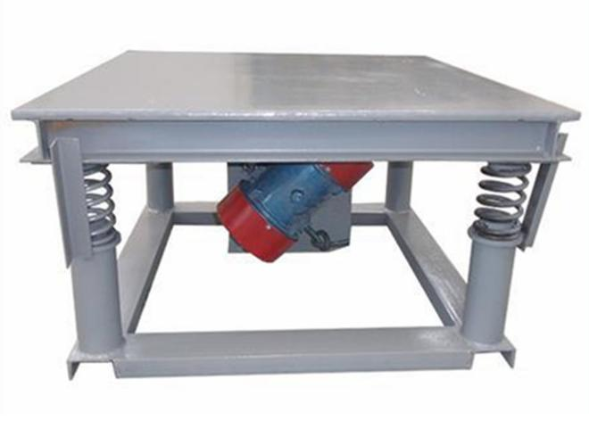
Technical/Other Constraints/Considerations
Filter accuracy and real-time performance - is a software filter too slow?
How is our system going to be powered?
Where are we going to store all of our data?
How do we go about testing our design and simulating flying an aircraft?
Pilot Biometric - ECG Waveform Captures sdmay18-12

Slide 7
Market Survey
Our product is designed to be used in U.S. Navy fighter pilot training programs for monitoring pilot health.
Our product will be unique in its use of ECG sensors in a highly turbulent environment. Any other market potential it has would likely be in monitoring the health of people in such a turbulent environment.
Pilot Biometric - ECG Waveform Captures sdmay18-12

Slide 8
Potential Risks & Mitigation
Device dying mid flight
Connect device to plane electrical system
Calculate pull of device and get battery size needed
Getting inaccurate ECG reading
Multileveled software filter for background noise and muscle movement
Extensive testing
Pilot information insecure
Encrypt data
Harness Interfering with piloting
Cockpit design
Common pilot movements
Pilot Biometric - ECG Waveform Captures sdmay18-12

Slide 9
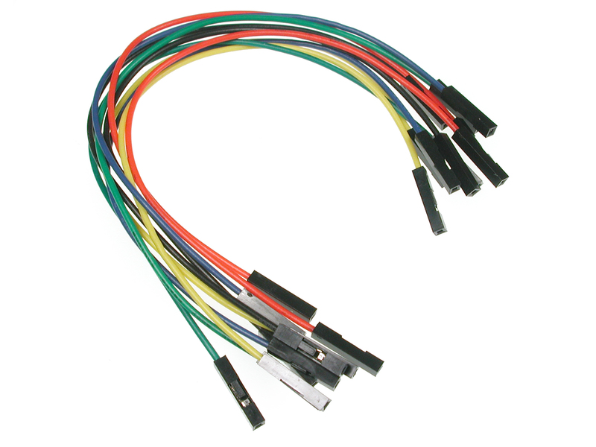
Resource/Cost Estimate
Hardware
ARM M7 Microcontroller
Analog to Digital Converter
ECG Sensors
Electrical misc.
Software
Micro C Linux
Pilot Biometric - ECG Waveform Captures sdmay18-12

Slide 10
Project Milestones & Schedule
Semester 1
Pilot Biometric - ECG Waveform Captures sdmay18-12

Slide 11
Project Milestones & Schedule
Semester 2
Pilot Biometric - ECG Waveform Captures sdmay18-12

Slide 12
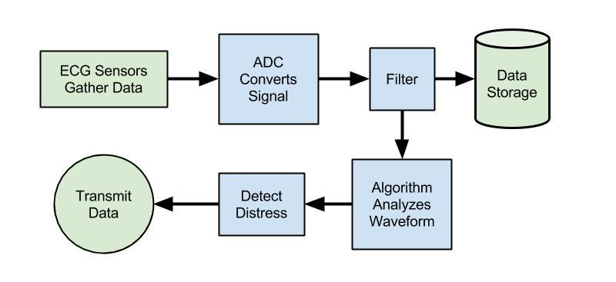
Functional Decomposition
Pilot Biometric - ECG Waveform Captures sdmay18-12

Slide 13
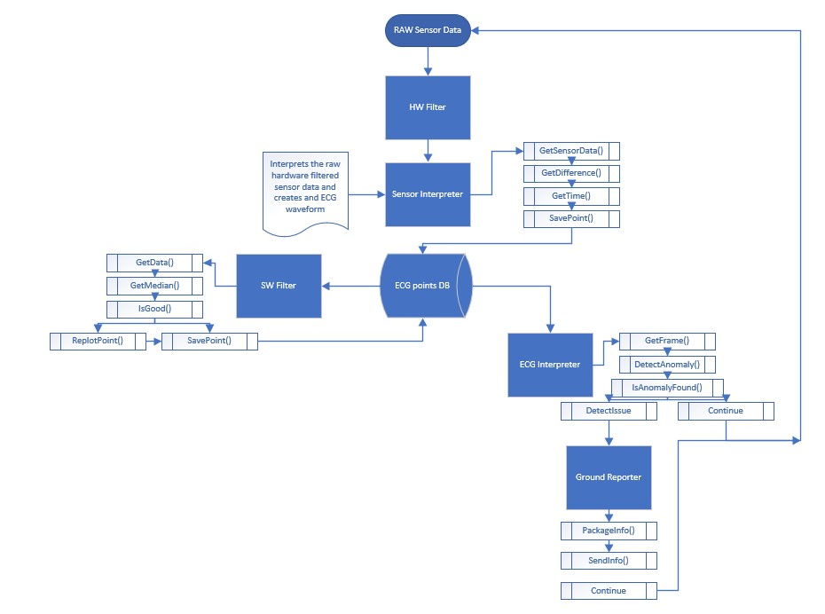
Detailed Design - Flow Diagram
4 major processes
Asynchronous
1 DB
Two Filters
1 HW
1 SW
Pilot Biometric - ECG Waveform Captures sdmay18-12

Slide 14
Detailed Design 2 - Database Tables
3 Tables
1 Unfiltered Data points
1 Filtered Data points
1 Detected Anomalies
UnfilteredPlot
Contains 4 Sensors plots
FilteredPlot
Contains data after SW filter and interpreted data.
DetectionTable
Contains any anomalies detected for investigation later.
Contains Start and End times of the anomaly in reference to FilteredPlot table
Pilot Biometric - ECG Waveform Captures sdmay18-12

Slide 15
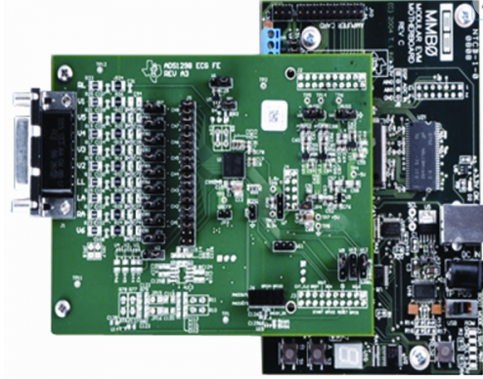
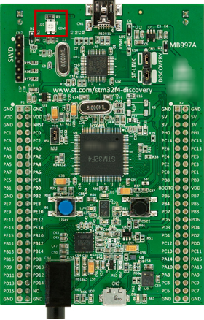
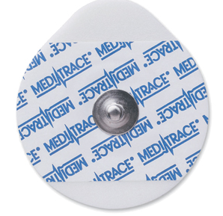
HW Platforms
ADS1298
8-Channel, 24 bit ADC
32,000 Samples per Second
STM34F746G discovery
ARM M7 Microcontroller
Kendall 530 Series Electrode
ADS1298
STM34
Electrode
Pilot Biometric - ECG Waveform Captures sdmay18-12

Slide 16
Platforms
Micro-c Linux
Installed on Microcontroller
SQL
Installed on micro-SD card that is attached to microcontroller
C/C++
Used to enable class usage
Easy process creation
Easy concurrent program running
Pilot Biometric - ECG Waveform Captures sdmay18-12

Slide 17
Test Plan 1
First Stage of Testing
Check interfacing between all components
Software Filters
Input from Sensors
Response time for Results
Accuracy of Results
Testing
Testing on all components must be done periodically
To ensure that the product as a whole is still functional
Goal is to have quick standard tests in order to verify each component after changes
Pilot Biometric - ECG Waveform Captures sdmay18-12

Slide 18
Test Plan 2
Final Stage of Testing
Will have opportunity to test product in real life scenario
Operator Performance Laboratory (OPL)
Gain feedback about comfortability
Test impact of a High vibration environment
Goal
With this test, we can understand how well our product can perform
We may also see opportunities to fix or improve upon the product
Pilot Biometric - ECG Waveform Captures sdmay18-12

Slide 19
Prototype Implementations 1
ECG sensor prototype
All components together
Should be able to use sensors to get raw data
Process that raw data
Test accuracy of that data
Breadboard
Will first use breadboard to test hardware filter
Allow use to test the hardware filter
Once we are confident with prototype a PCB board can be designed
Pilot Biometric - ECG Waveform Captures sdmay18-12

Slide 20
Prototype Implementations 2
Prototype for incorporation in harness
Must fit comfortably
Must hold sensors and product
Must be safe and not in the way of pilot
Prototype for harness will be made next semester
Prototype testing will provide much feedback
Will be able to use the prototype on a real subject (one of the team members)
Will be able to try to induce mild stress and use prototype to detect it
Will be able to see product as whole
Improve or fix any areas
Pilot Biometric - ECG Waveform Captures sdmay18-12

Slide 21
Current Project Status
Individually tested hardware components
ADC
Microcontroller
Research and assessed previous literature
Working with ECG waveforms
Storage requirements
Medical standards
Development started
Algorithm
Software filter
Pilot Biometric - ECG Waveform Captures sdmay18-12

Slide 22
Task Responsibility/Contributions
Ryan Gallus – Team Lead
Zach Glanz – Driver Design Lead
Justin Bader – Filter Design Lead
Andrew Jones – Algorithm Design Lead
Kory Gray – Operating Systems Lead
David Kirpes – Circuit Design Lead
Pilot Biometric - ECG Waveform Captures sdmay18-12

Slide 23
Plan for Next Semester
Finish Development
Implement ECG sensors into ADC and board
Finish writing main algorithm and software filter
Component Testing
Evaluate ECG sensors
Evaluate filter
Evaluate main algorithm
Prototype Testing
Induced stress test
Operator Performance Lab
Pilot Biometric - ECG Waveform Captures sdmay18-12

