Slide 1
Pilot Biometrics
ECG Waveform Captures
sdmay18-12
Team Members
Ryan Gallus, Andrew Jones, Justin Bader, Zach Glanz, Kory Gray, David Kirpes
Advisor: Professor Tyagi
Client: Rockwell Collins

Slide 2
Purpose
Provide critical medical information to decision makers about the condition of US Navy pilots during training missions
Notes:
Ryan

Slide 3
Project Overview
Capture, monitor, and analyze Electrocardiograph (ECG) waveform
Three ECG Sensors take voltage readings
Filtering remove interference noise
Analog to Digital Converter (ADC) converts signals
ECG waveform data fed into microcontroller
Copy stored on device (4-5 hours)
Copy packaged for output
Input into artificial neural network for stress detection
Battery and voltage regulator for 4-5 hours operation
Notes:
Ryan

Slide 4
Operational Environment
ECG sensors attached to user via disposable pads under flight suit
Used inside military aircraft cockpit
Rough shaking
Inconsistent vibrations
Movements from pilot
Unpredictable muscle contractions
High-g maneuvers
Pressurized cabin
Reasonable range of temperatures and humidity
Notes:
Ryan

Slide 5
Intended Users
US Navy fighter pilots in training
Pilots already certified to operate aircraft
In good health and physical condition
Practicing missions with multiple aircraft
Extracted data can be transmitted to ground in real time
Data used by training and health officers
Determine whether or not to continue mission
Confirm if pilot is fit to continue training
Identify health issues early
Notes:
Ryan

Slide 6
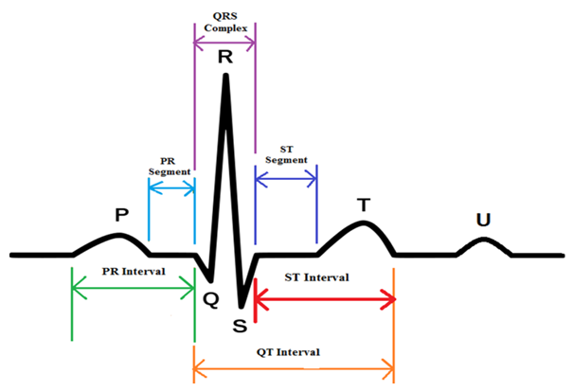
ECG Waveform
Captured using 3-Leads
R-Wave
Used to detect Heart-Rate
Easy to capture
QT Interval
Time from start of R-wave to the end of T-wave
Not as reliable to capture
Notes:
Bader

Slide 7
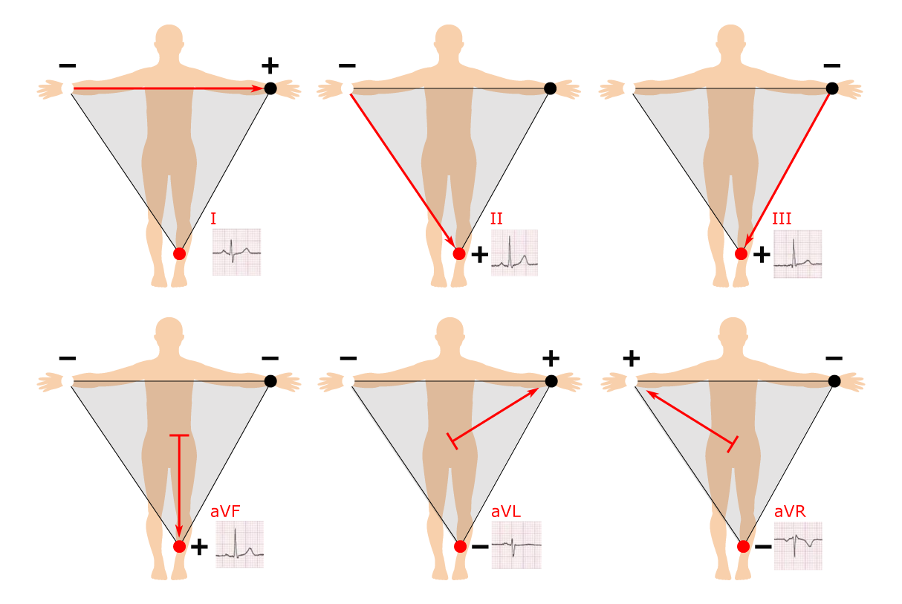
Detecting Stress
Heart-Rate Variability
Measure variability between R-waves
Easily Implemented with ECG
High variability is indicator of stress
QT Interval
Measurement of QT intervals
Difficult to implement accurately
Decreased interval indicates stress
Notes:
Bader

Slide 8
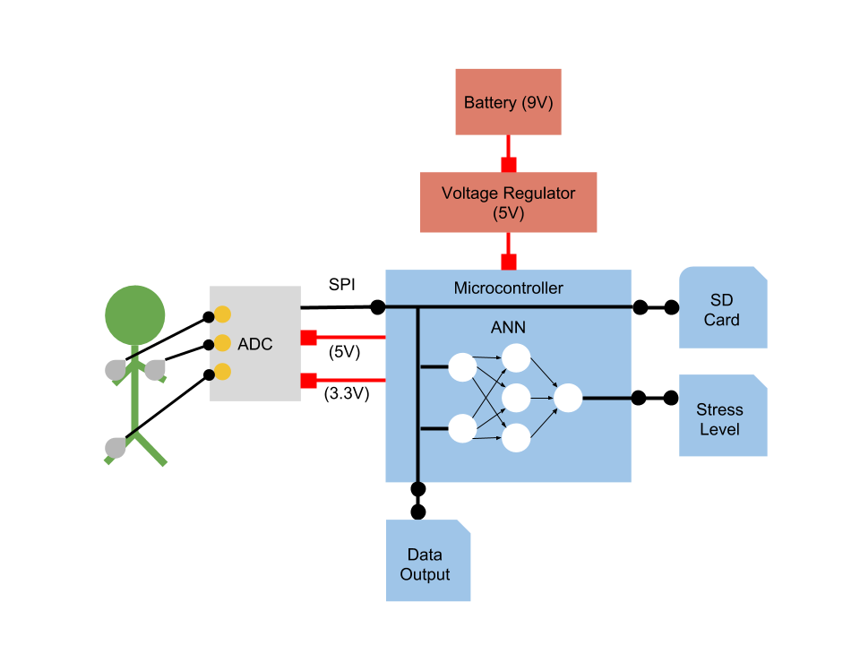
System Diagram
Notes:
Bader

Slide 9
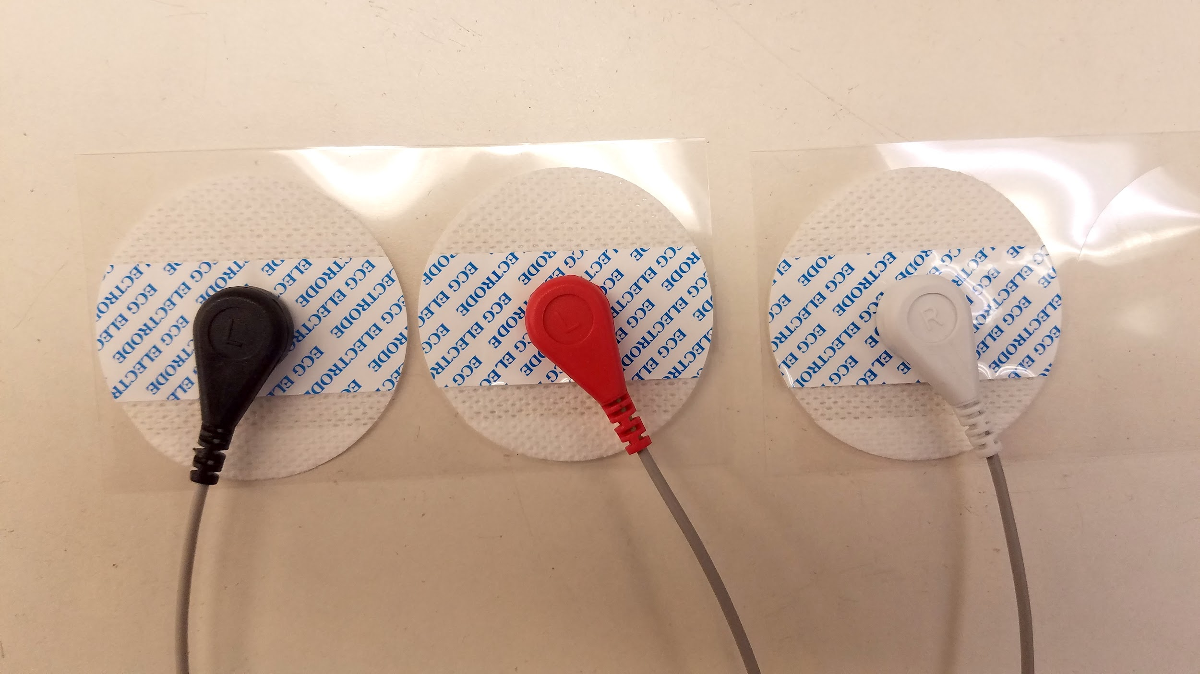
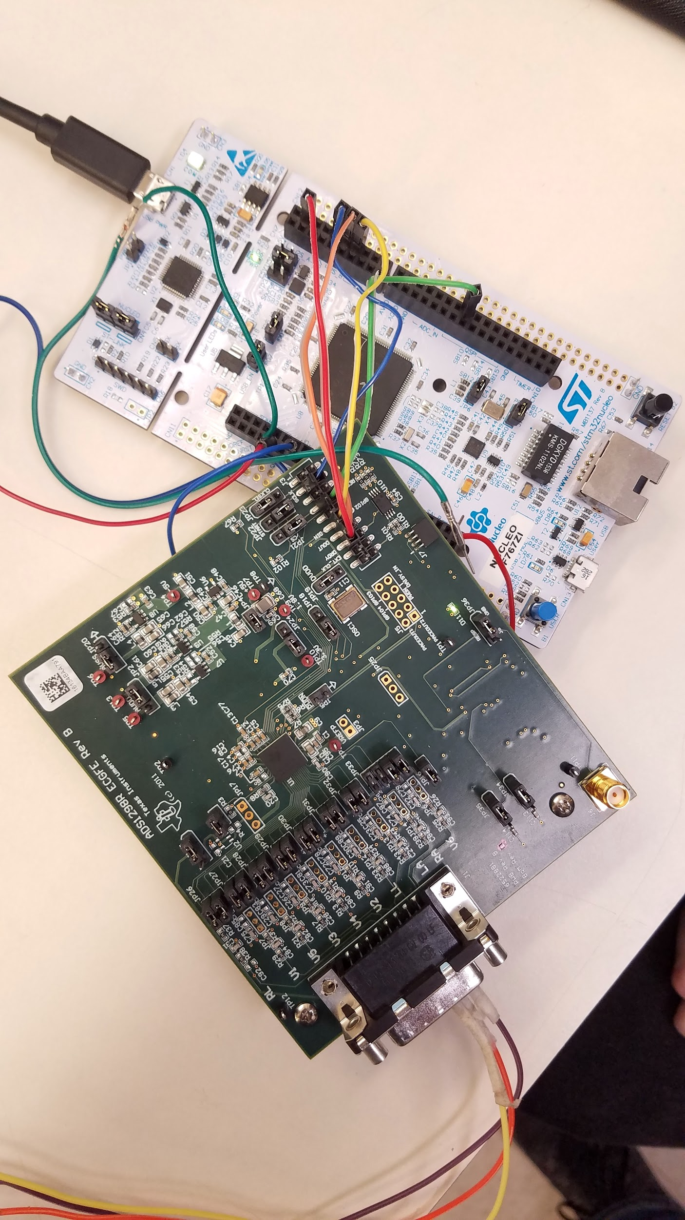
Hardware
ADS1298R (Pictured)
24-bit ADC
Built in hardware frequency filter
Nucleo-144 (Pictured)
Used in place of permanent microcontroller
Communicates over SPI
ECG Leads (Pictured)
STM32F746G Discovery
Notes:
Bader

Slide 11
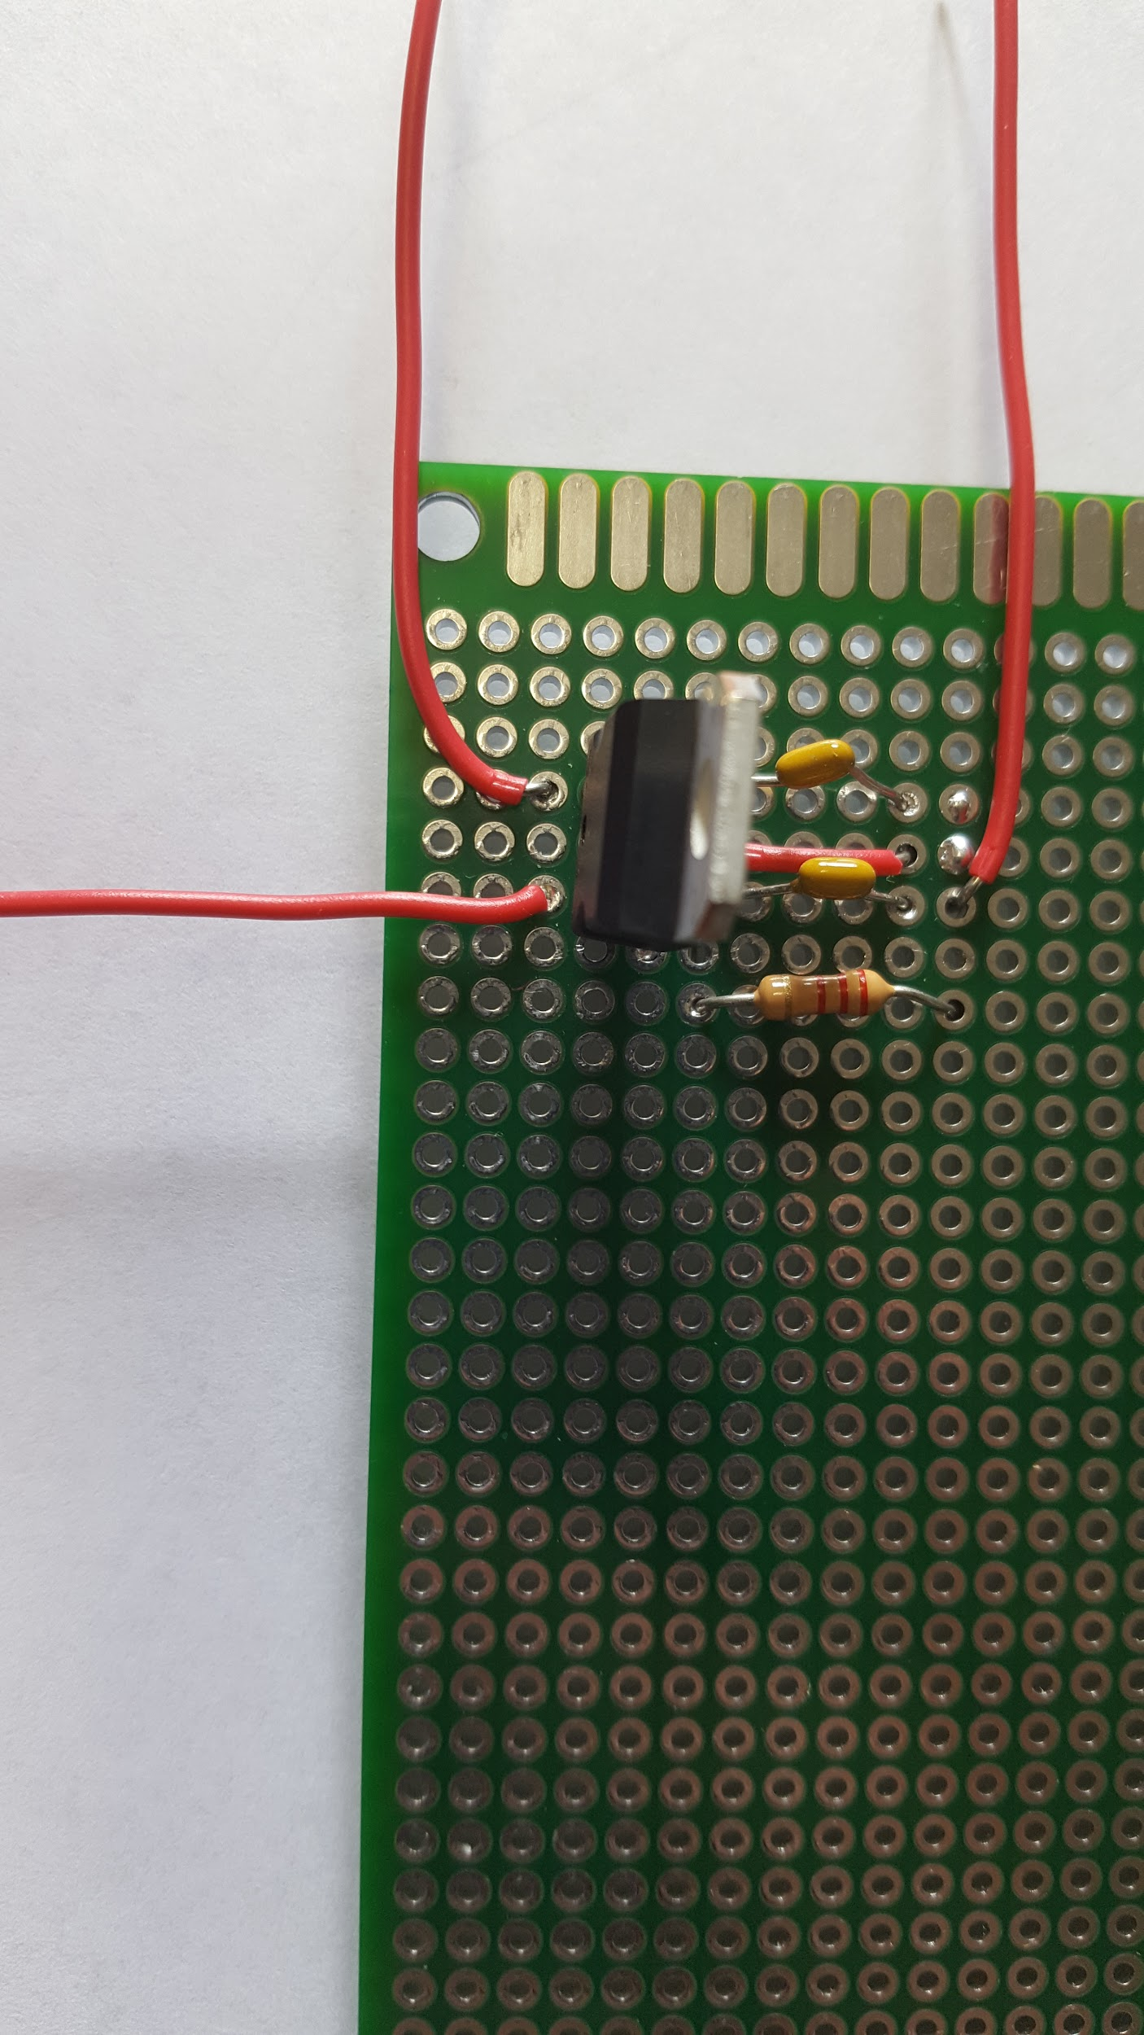
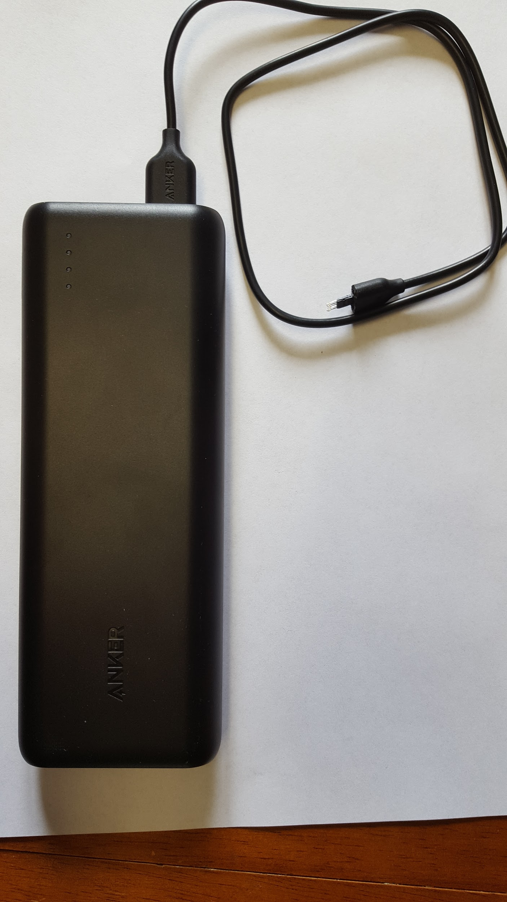
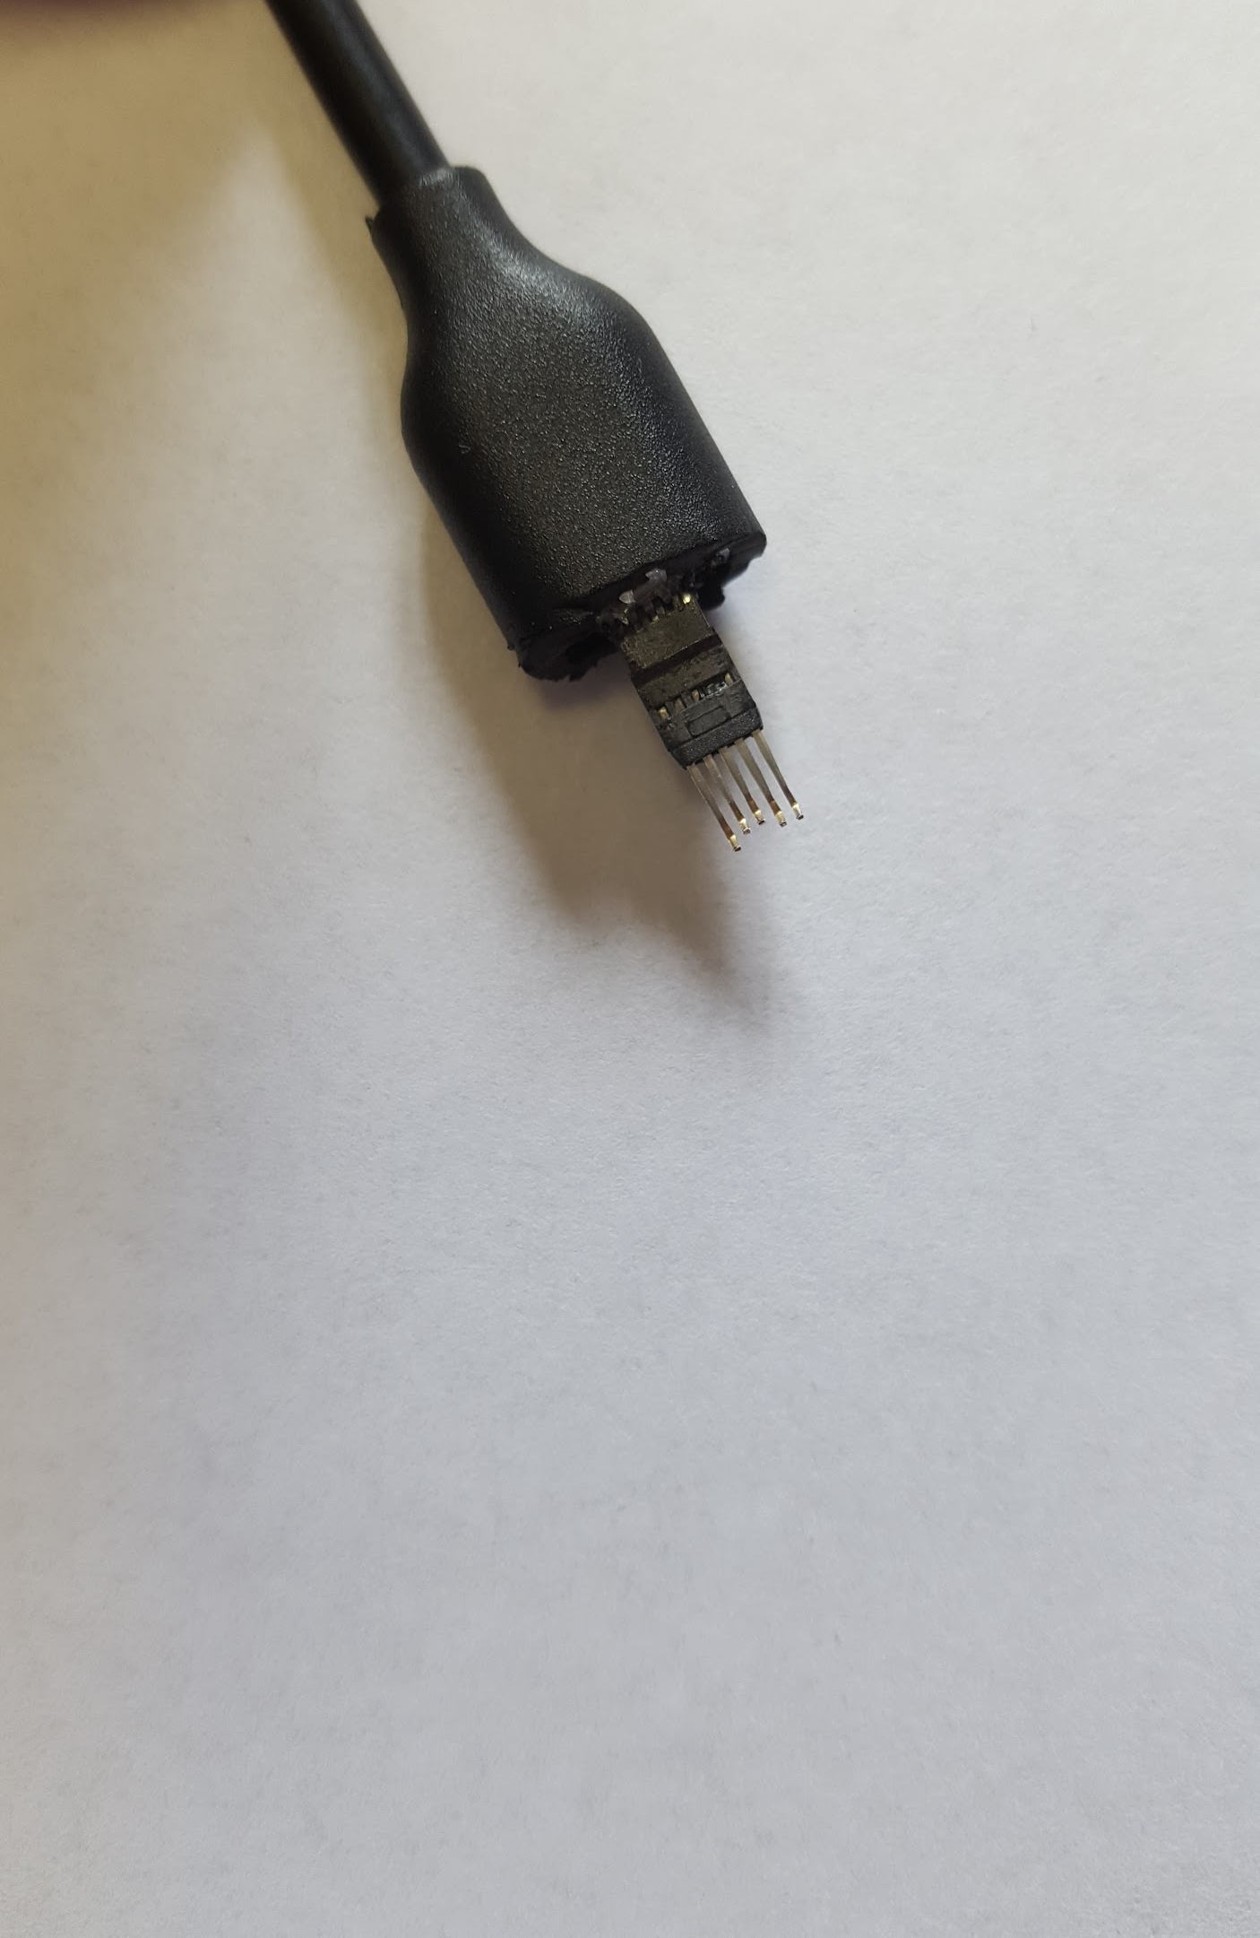
Voltage Regulator & Battery
Voltage Regulator Battery Power Cord
Vin(9V)
Ground
Ground
Vout(5V)
Vout
Notes:
Kory - Connect vout from power cord to vin on the voltage regulator. Connect ground to ground. Vout from power regulator powers microcontroller. Resistor and capacitor values do not matter.

Slide 12
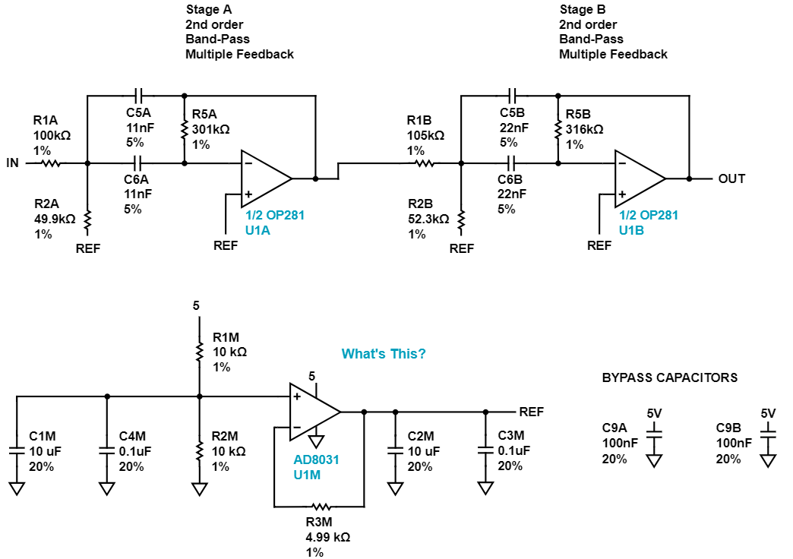
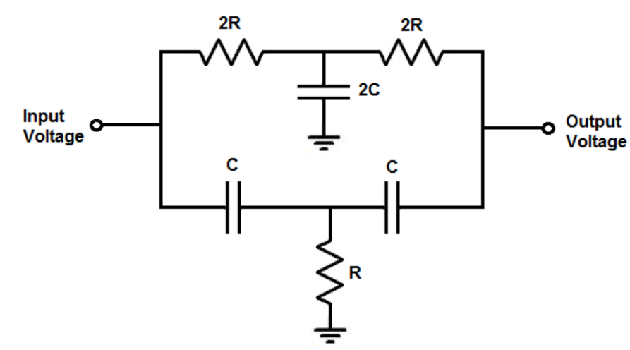
Filters
Bandpass Filter
Notch Filter
Offset Voltage
Notes:
Kory - Two stage fourth-order Butterworth bandpass filter. 100nF and 13.3k Ohm for the notch filter. Offset voltage provides reference voltage for op amps since the battery only supplies a positive input voltage.
AD8031 is just a feedback voltage amplifier.

Slide 13
Analog to Digital Converter
24-bit ADC
Communication with microcontroller over SPI
Operating at 8,000 samples-per-second
Using 3 leads for ECG detection
Disposable ECG sensor pads placed on skin
Return voltage readings
Challenges
Evaluation module PCB designed for 12-lead system.
Evaluation module designed to work with companion board that is only compatible with Windows XP-7
Notes:
Zach

Slide 14
Microcontroller
SPI Interface with ADC
ADC output written to board registers
C++ application reads registers and directs data flow
STM32F746G Discovery Board
Linux Development Environment
Reconfigure u-boot and put uClinux on quad-SPI flash memory on board to boot
Reconfigure uClinux image to use SPI and store to microSD card
Notes:
Zach

Slide 15
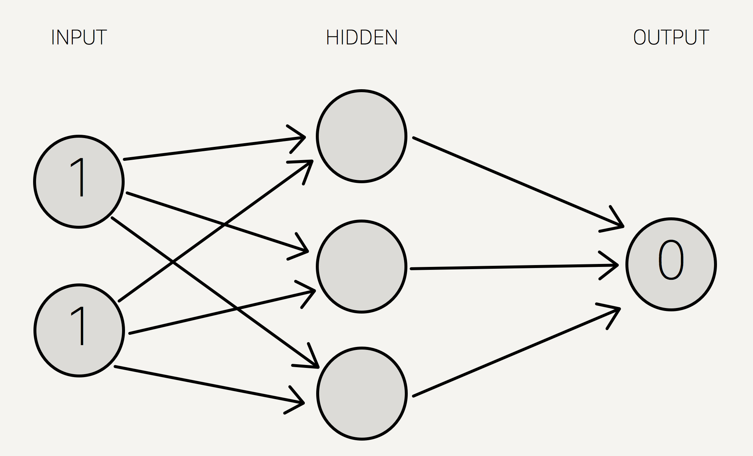
Artificial Neural Network
Stress Detection
Given a set of training data, will learn whether an individual is stressed or not
Uses Heart Rate Variability as the metric to detect cognitive stress
Time domain measurement NN50
Can tweek itself over time to with individual pilots
Notes:
Andrew

Slide 16
Data Collection
Control Data
Measuring time between R-waves of user at rest
Single task that is uncomplicated
Stressed Data
Measuring time between R-waves of user doing mentally straining tasks until failure
Starts with single spatial navigation task
Additional cognitive tasks added until subject feels overly stressed
Notes:
Andrew

Slide 17
Testing
Component Testing
Individually test hardware components
Test battery performance/lifetime and data storage requirements
ECG Waveform Testing
Compare device output against sample ECG data
Test on multiple subjects for anomalies
Artificial Neural Network Testing
Train with labeled data
Validate with test data and adjust weights for accuracy
Notes:
Andrew

Slide 18
Questions?
Team Members
Ryan Gallus
Andrew Jones
Justin Bader
Zach Glanz
Kory Gray
David Kirpes*
*Not presenting

